Slide 1
Fundamentals
Data

Slide 2
Outline
Visualization
Discretization
Sampling
Quantization
Representation
Continuous
Discrete
Noise

Slide 3
Data

Slide 4
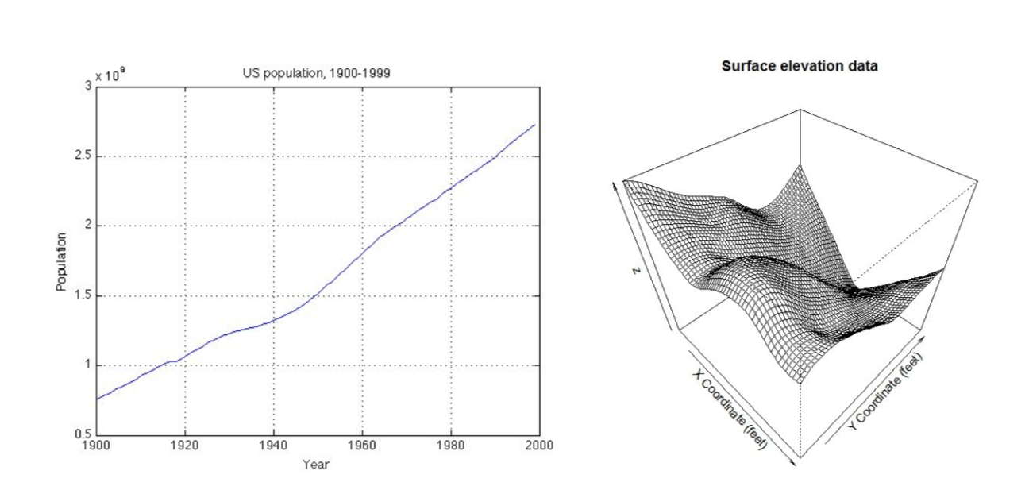
Data (1D and 2D)
Plot of dependent variable with respect to independent ones
2D plot is a height field

Slide 5
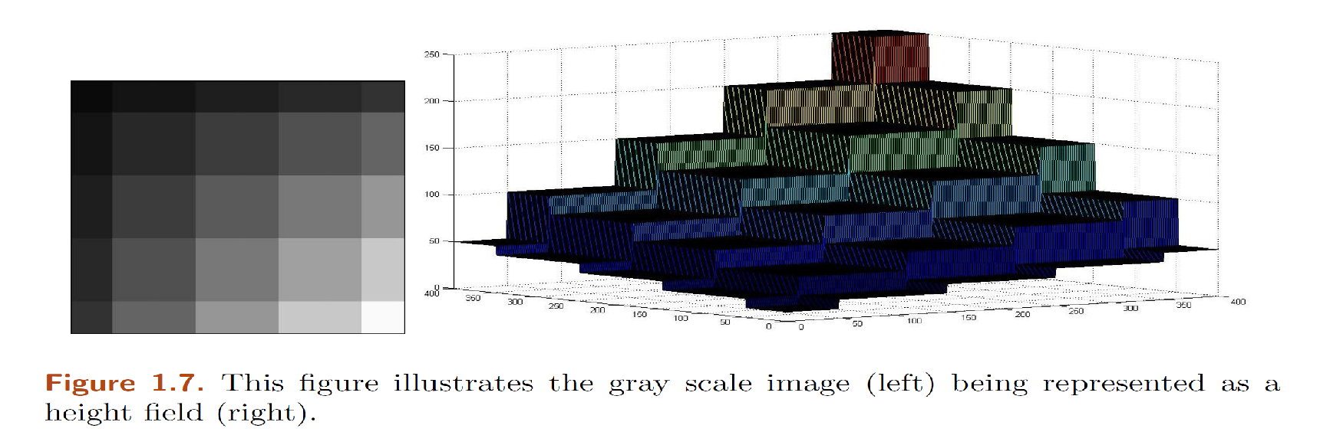
Two image representations

Slide 6
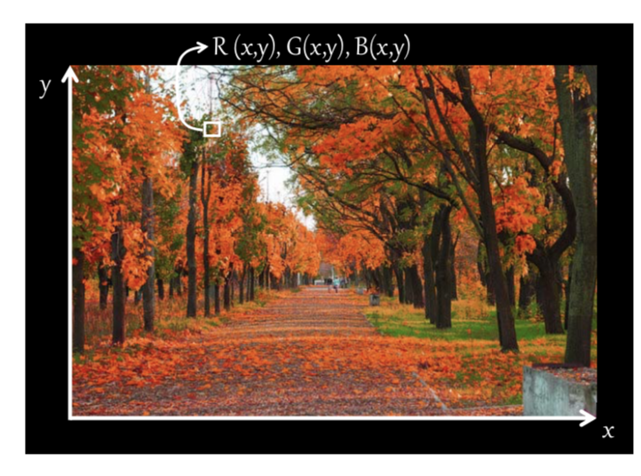
Color Image Representation

Slide 7
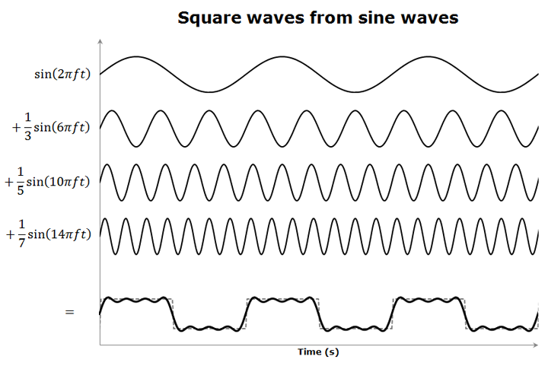
An Alternative Representation (1D)

Slide 8
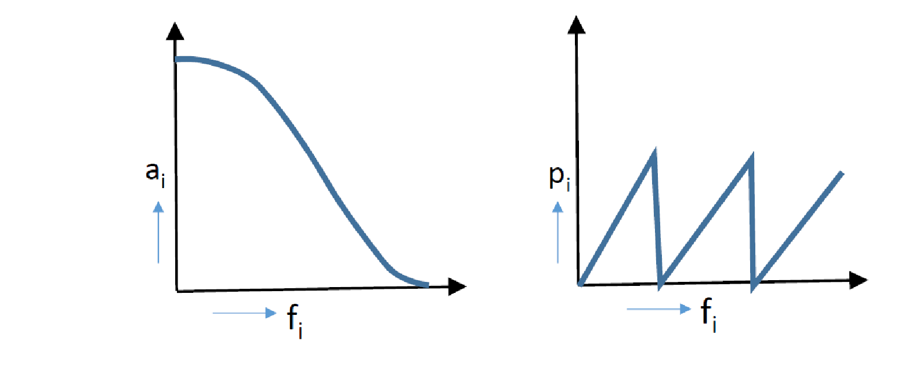
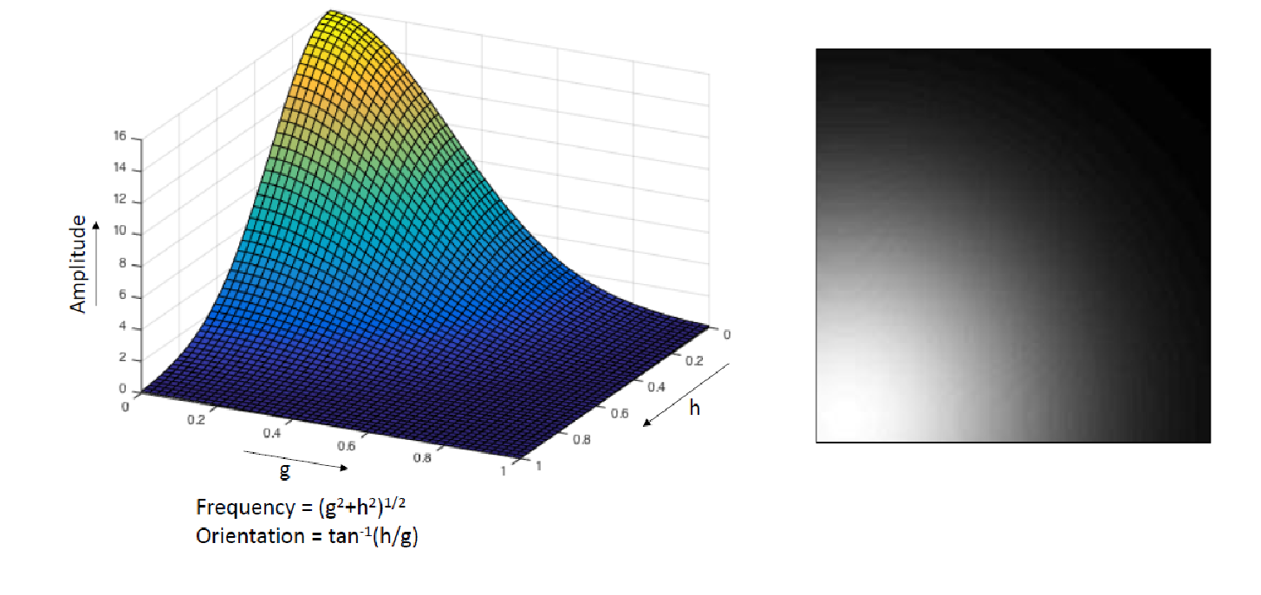
Frequency Domain Representation
Frequency
Amplitude and Phase
What about 2D?
Frequency and Orientation
Polar Representation

Slide 9
Discretization
Data exists in nature as a continuous function.
Convert to discrete function for digital representation
Discretization
Two concepts
Sampling
Quantization

Slide 10
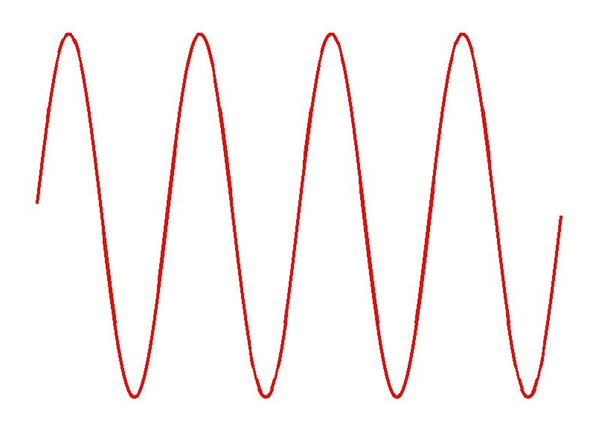
Sampling
t
Sampling

Slide 11
Uniform vs Non-uniform sampling
Uniform
Non-uniform

Slide 12
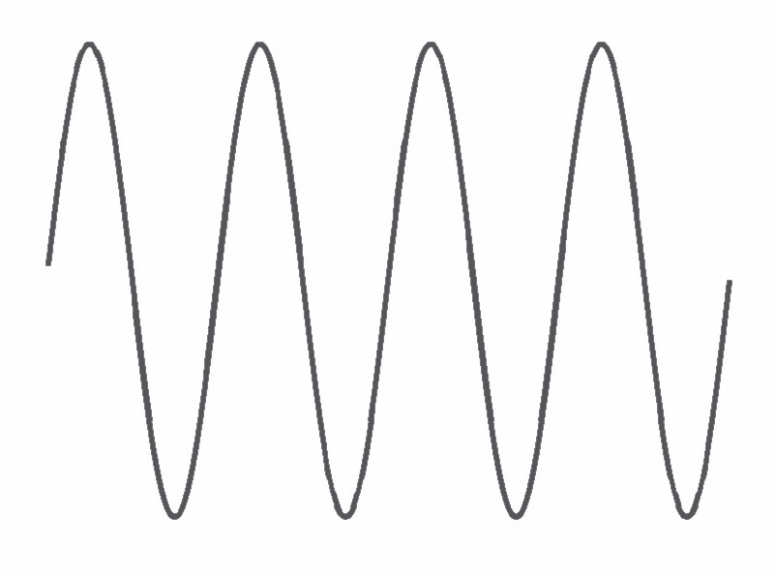
Reconstruction
Get the continuous function from the discrete function
Sampling
Correct Reconstruction

Slide 13
Reconstruction
Accurate reconstruction needs adequate samples
Sampling
Incorrect Reconstruction

Slide 14
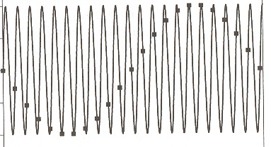
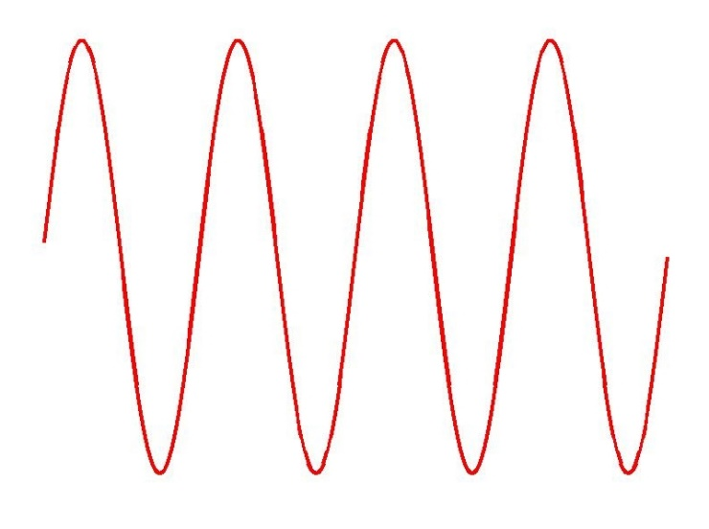
Aliasing
Incorrect representation of some entity
A much lower frequency
Zero frequency

Slide 15
Nyquist Sampling Rate
By sampling at least twice the frequency (2 samples per cycle), signal can be reconstructed correctly.
t
Sampling
Correct Reconstruction

Slide 16
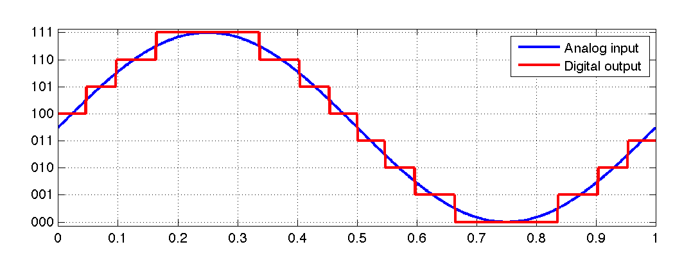
Quantization
A analog signal can have any value of infinite precision
Digital signal can only have a limited set of value
Step Size
Max error
½ step size

Slide 17
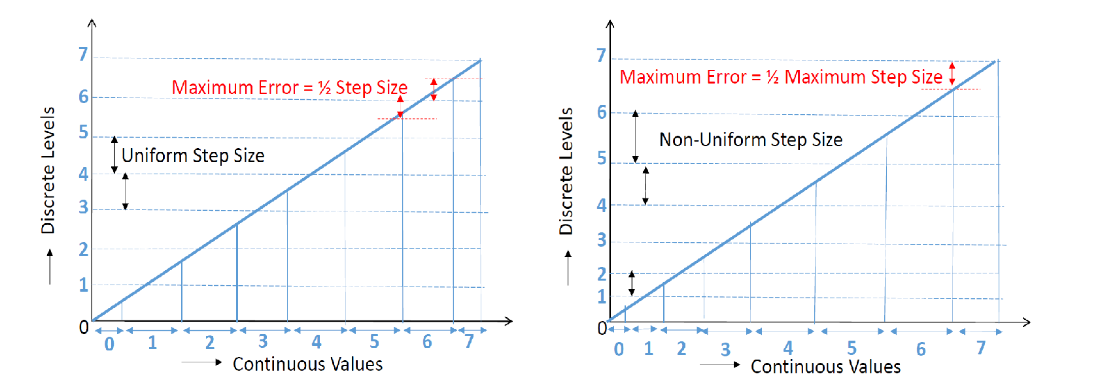
Quantization Error

Slide 18
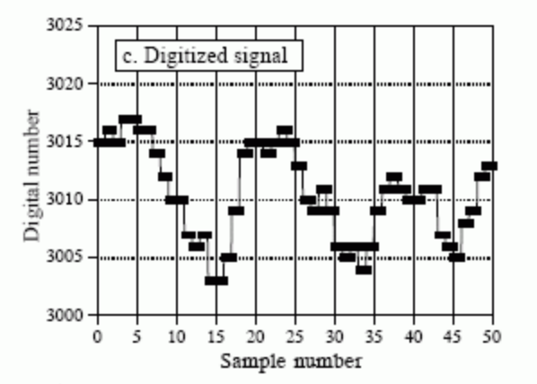
Quantization
Depends on number of bits
12 bits = 4095 levels
0.0 ≤ Voltage ≤4.096
2.56 and 2.5601 TO 2560
Each level (LSB) = 0.001
Error ≤ ±½ LSB
Called Quantization Error

Slide 19
Noise
Addition of random values at random locations in the data.
Random noise

Slide 20
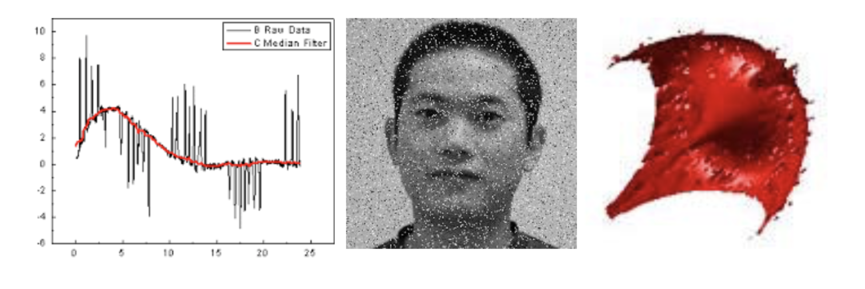
Noise
Outlier Noise
An example of such noise is salt and pepper noise
Can be solved by Median filter

Slide 21
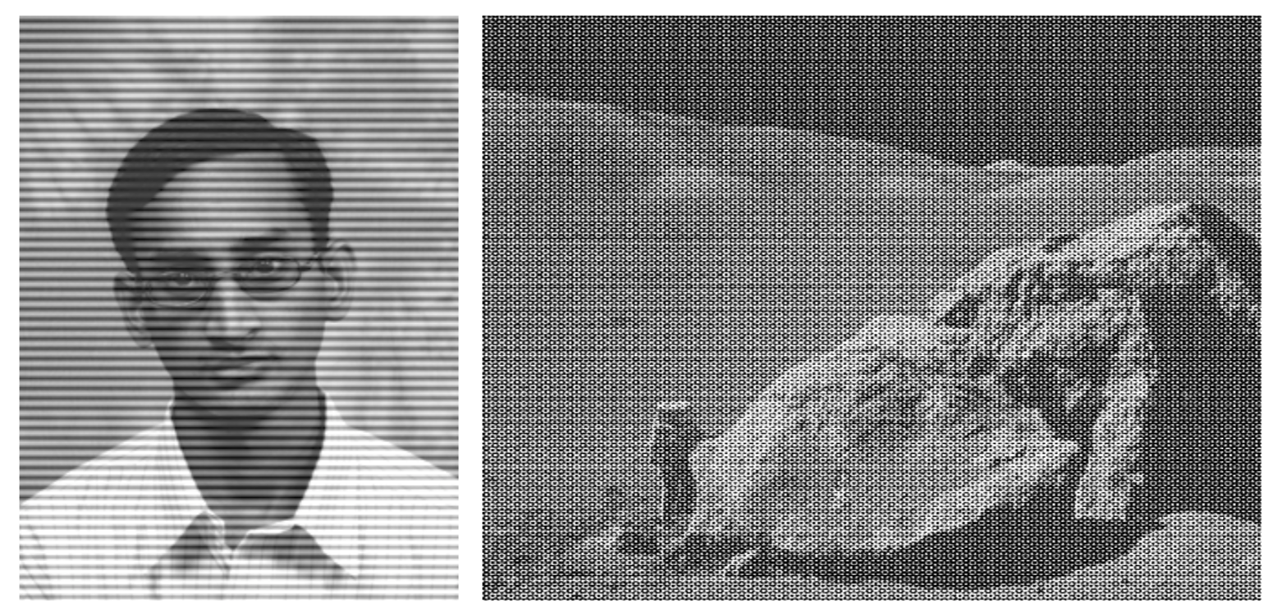
Noise
Some noise look random in spatial domain but can be isolated to a few frequencies in spectral domain.
Can be removed by Notch filter.

Slide 22
Technqiues
Interpolation
Linear Interpolation
Bilinear Interpolation
Geometric Intersections

Slide 23
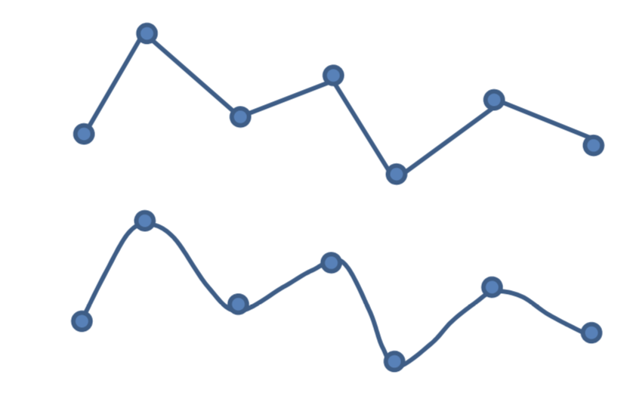
Interpolation
Estimate function for values which it has not been measured.
Linear interpolation:
Assuming a line between samples.
Change abruptly at sample points
No gradient continuity

Slide 24
Interpolation
Non-linear interpolation:
A smooth curve passes through samples
First derivative continuous
Second derivative continuous

Slide 25
Linear Interpolation

Slide 26
Bilinear Interpolation
2D Data
Interpolating in one direction followed by interpolating in the second direction.

